Slide 1



UNIVERSITY INSTITUTE OF ENGINEERING
COMPUTER SCIENCE ENGINEERING
Bachelor of Engineering
Design and Analysis of Algorithms(CST-302/ITT-302)
Prepared By: Amrita Chaudhary (E8745)
Topic: Optimal Merge tree
DISCOVER . LEARN . EMPOWER

Slide 2
Optimal merge patterns
Merge a set of sorted files of different length into a single sorted file. We need to find an optimal solution, where the resultant file will be generated in minimum time.
If the number of sorted files are given, there are many ways to merge them into a single sorted file. This merge can be performed pair wise. Hence, this type of merging is called as 2-way merge patterns.
As, different pairings require different amounts of time, in this strategy we want to determine an optimal way of merging many files together. At each step, two shortest sequences are merged.

Slide 3
To merge a p-record file and a q-record file requires possibly p + q record moves, the obvious choice being, merge the two smallest files together at each step.
Two-way merge patterns can be represented by binary merge trees. Let us consider a set of n sorted files {f₁, f₂, f₃, …, f_{n}}. Initially, each element of this is considered as a single node binary tree. To find this optimal solution, the following algorithm is used.

Slide 4
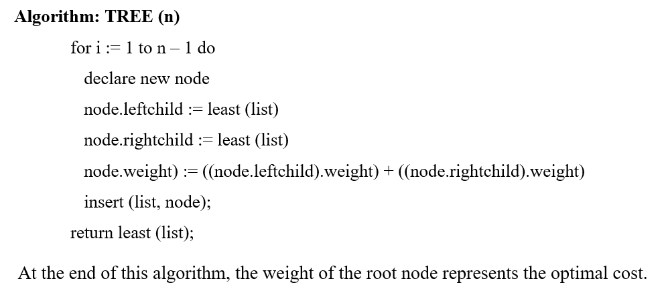
Algorithm

Slide 5
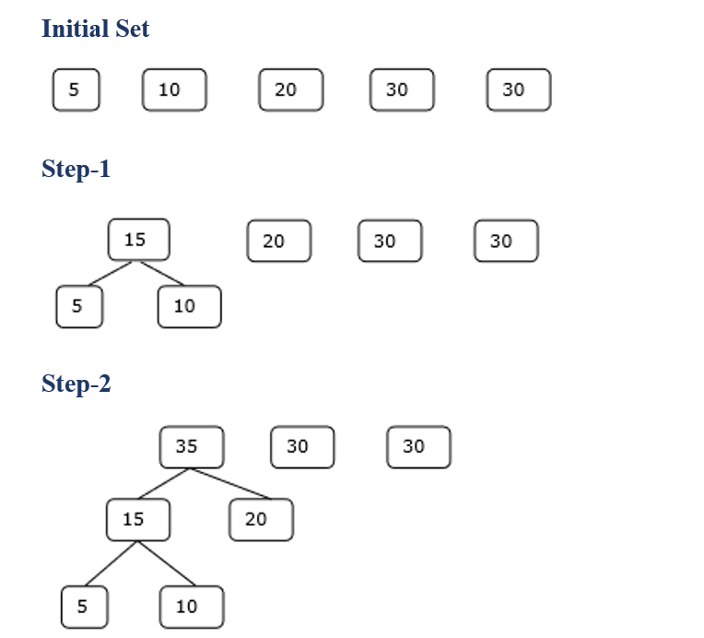
Example

Slide 6
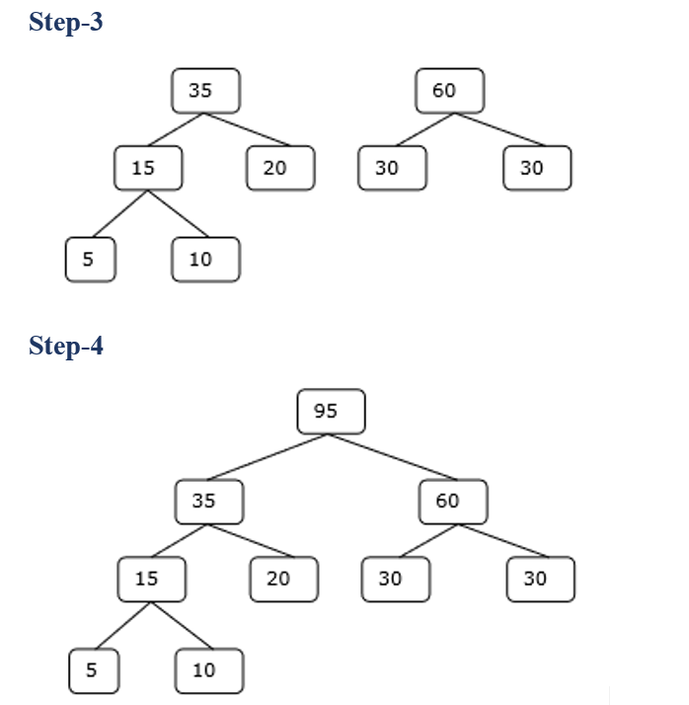
Hence, the solution takes 15 + 35 + 60 + 95 = 205 number of comparisons.

Slide 7
Poll Question
4) What will be the cost of the code if character c_{i} is at depth d_{i} and occurs at frequency f_{i}?
a) c_{i}f_{i}
b) ∫c_{i}f_{i}
c) ∑f_{i}d_{i.}
d) f_{i}d_{i}

Slide 8
REFERENCES
Text books:
Cormen, Leiserson, Rivest, Stein, “Introduction to Algorithms”, Prentice Hall of India, 3rd edition 2012. problem, Graph coloring.
Websites:
https://www.geeksforgeeks.org/huffman-coding-greedy-algo-3/
https://www.programiz.com/dsa/huffman-coding
https://www.tutorialspoint.com/design_and_analysis_of_algorithms/design_and_analysis_of_algorithms_optimal_merge_pattern.htm#:~:text=Merge%20a%20set%20of%20sorted,into%20a%20single%20sorted%20file.

Slide 9
Summary
    Huffman Coding
    Optimal Merge Pattern

Slide 10
THANK YOU

